Slide 1


International Economics: Theory and Policy
Twelfth Edition
Chapter 7
External Economies of Scale and the International Location of Production
Copyright © 2022, 2018, 2015 Pearson Education, Inc. All Rights Reserved
Notes:
If this PowerPoint presentation contains mathematical equations, you may need to check that your computer has the following installed:
1) MathType Plugin
2) Math Player (free versions available)
3) NVDA Reader (free versions available)

Slide 2
Learning Objectives
7.1 Recognize why international trade often occurs from increasing returns to scale.
7.2 Understand the differences between internal and external economies of scale.
7.3 Discuss the sources of external economies.
7.4 Discuss the roles of external economies and knowledge spillovers in shaping comparative advantage and international trade patterns.

Slide 3
Preview
Types of economies of scale
Economies of scale and market structure
The theory of external economies
External economies and international trade
Dynamic increasing returns
International trade and economic geography

Slide 4
Introduction (1 of 4)
The models of comparative advantage thus far assumed constant returns to scale:
When inputs to an industry increase at a certain rate, output increases at the same rate.
If inputs to an industry were doubled, industry output would double as well.

Slide 5
Introduction (2 of 4)
But there may be increasing returns to scale or economies of scale:
This means that when inputs to an industry increase at a certain rate, output increases at a faster rate.
A larger scale is more efficient: the cost per unit of output falls as a firm or an industry increases output.

Slide 6
Introduction (3 of 4)
For example, suppose an industry produces widgets using only one input, labor.
Consider how the amount of labor required depends on the number of widgets produced.
The presence of economies of scale may be seen from the fact that
doubling the input of labor more than doubles the industry’s output.
the average amount of labor used to produce each widget is less when the industry produces more.

Slide 7
Table 7.1 Relationship of Input to Output for a Hypothetical Industry
Output | Total Labor Input | Average Labor Input
5 | 10 | 2
10 | 15 | 1.5
15 | 20 | 1.333333
20 | 25 | 1.25
25 | 30 | 1.2
30 | 35 | 1.166667

Slide 8
Introduction (4 of 4)
Mutually beneficial trade can arise as a result of economies of scale.
International trade permits each country to produce a limited range of goods without sacrificing variety in consumption.
With trade, a country can take advantage of economies of scale to produce more efficiently than if it tried to produce everything for itself.

Slide 9
Economies of Scale and Market Structure (1 of 2)
Economies of scale could mean either that larger firms or a larger industry would be more efficient.
External economies of scale occur when the cost per unit of output depends on the size of the industry.
Internal economies of scale occur when the cost per unit of output depends on the size of the firm.

Slide 10
Economies of Scale and Market Structure (2 of 2)
Both external and internal economies of scale are important causes of international trade.
They have different implications for the structure of industries:
An industry where economies of scale are purely external will typically consist of many small firms and be perfectly competitive.
Internal economies of scale result when large firms have a cost advantage over small firms, causing the industry to become imperfectly competitive.

Slide 11
The Theory of External Economies (1 of 6)
This chapter deals with a model of external economies; the next chapter will cover internal economies.
Many modern examples of industries that seem to be powerful external economies:
In the United States, the semiconductor industry is concentrated in Silicon Valley, investment banking in New York, and the entertainment industry in Hollywood.

Slide 12
The Theory of External Economies (2 of 6)
In developing countries such as China, external economies are pervasive in manufacturing.
One town in China produces most of the world’s underwear production, another produces nearly all cigarette lighters.
External economies played a key role in India’s emergence as a major exporter of information services.
Indian information services companies are still clustered in Bangalore.

Slide 13
The Theory of External Economies (3 of 6)
For a variety of reasons, concentrating production of an industry in one or a few locations can reduce the industry’s costs, even if the individual firms in the industry remain small.
External economies may exist for a few reasons:

Slide 14
The Theory of External Economies (4 of 6)
Specialized equipment or services may be needed for the industry, but are only supplied by other firms if the industry is large and concentrated.
For example, Silicon Valley in California has a large concentration of silicon chip companies, which are serviced by companies that make special machines for manufacturing silicon chips.
These machines are cheaper and more easily available there than elsewhere.

Slide 15
The Theory of External Economies (5 of 6)
Labor pooling: a large and concentrated industry may attract a pool of workers, reducing employee search and hiring costs for each firm.
Knowledge spillovers: workers from different firms may more easily share ideas that benefit each firm when a large and concentrated industry exists.

Slide 16
The Theory of External Economies (6 of 6)
Represent external economies simply by assuming that the larger the industry, the lower the industry’s costs.
There is a forward-falling supply curve: the larger the industry’s output, the lower the price at which firms are willing to sell.
Without international trade, the unusual slope of the supply curve doesn’t matter much.

Slide 17
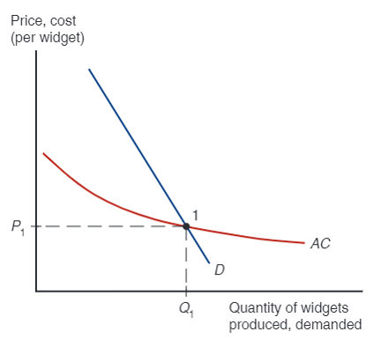
Figure 7.1 External Economies and Market Equilibrium
When there are external economies of scale, the average cost of producing a good falls as the quantity produced rises. Given competition among many producers, the downward-sloping average cost curve A C can be interpreted as a forward-falling supply curve. As in ordinary supply-and-demand analysis, market equilibrium is at point 1, where the supply curve intersects the demand
curve, D. The equilibrium level of output is
the equilibrium price
Notes:
The Ay C, average cost, curve is falls with decreasing steepness to almost flat, or forward-falling. It intersects the steeply falling D curve, a line, at point 1, where x = Q sub 1 and y = P sub 1.

Slide 18
External Economies and International Trade (1 of 10)
Prior to international trade, equilibrium prices and output for each country would be at the point where the domestic supply curve intersects the domestic demand curve.
Suppose Chinese button prices in the absence of trade would be lower than U.S. button prices.

Slide 19
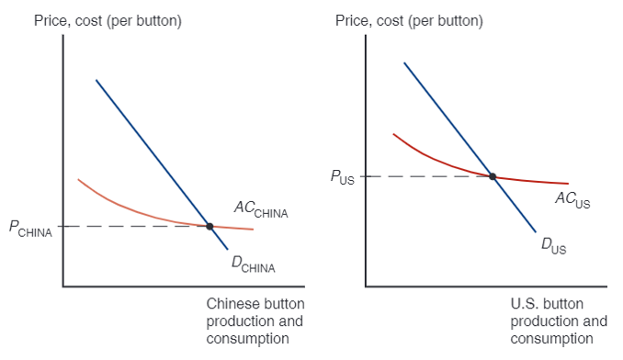
Figure 7.2 External Economies Before Trade
In the absence of trade, the price of buttons in China,
is lower than the price of buttons in the United States,
Notes:
The first graph plots price, cost per button versus Chinese button production and consumption. A forward falling Ay C China curve intersects a steeply falling D China curve at y = P China. The second graph plots price, cost per button versus U S button production and consumption. A forward falling Ay C U S curve intersects a steeply falling D U S curve at y = P U S. The intersection point is higher than the intersection point for China in the first graph.

Slide 20
External Economies and International Trade (2 of 10)
What will happen when the countries open up the potential for trade in buttons?
The Chinese button industry will expand, while the U.S. button industry will contract.
This process feeds on itself: As the Chinese industry’s output rises, its costs will fall further; as the U.S. industry’s output falls, its costs will rise.
In the end, all button production will be in China.

Slide 21
External Economies and International Trade (3 of 10)
How does this concentration of production affect prices?
Chinese button prices were lower than U.S. button prices before trade.
Because China’s supply curve is forward-falling, increased production as a result of trade leads to a button price that is lower than the price before trade.
Trade leads to prices that are lower than the prices in either country before trade!

Slide 22
External Economies and International Trade (4 of 10)
This is very different from the implications of models without increasing returns.
In the standard trade model, relative prices converge as a result of trade.
If cloth is relatively cheap in the home country and relatively expensive in the foreign country before trade opens, the effect of trade was to raise cloth prices in Home and reduce them in Foreign.
With external economies, by contrast, the effect of trade is to reduce prices everywhere.

Slide 23
Figure 7.3 Trade and Prices
When trade is opened, China ends up producing buttons for the world market, which consists both of its own domestic market and of the U.S. market. Output
rises from
leading to a fall in the price of buttons from
which is lower than the price of buttons in either country before trade.
Notes:
Curve D China intersects the curve for Ay C China at (Q sub 1, P sub 1). Curve D world intersects the curve for Ay C China at (Q sub 2, P sub 2). The intersection for D world is lower and to the right of the intersection for D China.

Slide 24
External Economies and International Trade (5 of 10)
What might cause one country to have an initial advantage from having a lower price?
One possibility is comparative advantage due to underlying differences in technology and resources.
If external economies exist, however, the pattern of trade could be due to historical accidents:
Countries that start as large producers in certain industries tend to remain large producers even if another country could potentially produce more cheaply.

Slide 25
External Economies and International Trade (6 of 10)
A tufted blanket, crafted as a wedding gift by a 19th-century teenager, gave rise to the cluster of carpet manufacturers around Dalton, Georgia.
Silicon Valley may owe its existence to two Stanford graduates named Hewlett and Packard who started a business in a garage there.

Slide 26
External Economies and International Trade (7 of 10)
Assume that the Vietnamese cost curve lies below the Chinese curve because Vietnamese wages are lower than Chinese wages.
At any given level of production, Vietnam could manufacture buttons more cheaply than China.
One might hope that this would always imply that Vietnam will in fact supply the world market.
But this need not always be the case if China has enough of a head start.
No guarantee that the right country will produce a good that is subject to external economies.

Slide 27
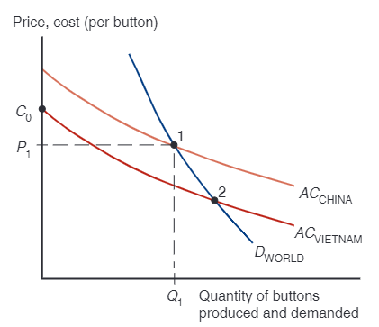
Figure 7.4 The Importance of Established Advantage
The average cost curve for Vietnam,
lies below the average cost
curve for China,
Thus Vietnam could potentially supply the world market
more cheaply than China. If the Chinese industry gets established first, however,
it may be able to sell buttons at the price
which is below the cost
that an individual Vietnamese firm would face if it began production on its own. So a pattern of specialization established by historical accident may persist even when new producers could potentially have lower costs.
Notes:
The curve for D world falls with decreasing steepness and intersects the curve for Ay C China, which falls less steeply, at point 1, at (Q sub 1, P sub 1). The curve for Ay C Vietnam is below and parallel to Ay C China, and falls with decreasing steepness from y = C sub 0, which is roughly midway between y = P sub 1 and the y-intercept of the Ay C China curve. The Ay C Vietnam curve intersects the D world curve at point 2, which is lower and to the right of point 1.

Slide 28
External Economies and International Trade (8 of 10)
Trade based on external economies has an ambiguous effect on national welfare.
There will be gains to the world economy by concentrating production of industries with external economies.
It’s possible that a country is worse off with trade than it would have been without trade: a country may be better off if it produces everything for its domestic market rather than pay for imports.

Slide 29
External Economies and International Trade (9 of 10)
Imagine that Thailand could make watches more cheaply, but Switzerland got there first.
The price of watches could be lower in Thailand with no trade.
Trade could make Thailand worse off, creating an incentive to protect its potential watch industry from foreign competition.
What if Thailand reverts to autarky?

Slide 30
External Economies and International Trade (10 of 10)
Note that it’s still to the benefit of the world economy to take advantage of the gains from concentrating industries.
Each country wanting to reap the benefits of housing an industry with economies of scale creates trade conflicts.
Overall, it’s better for the world that each industry with external economies be concentrated somewhere.

Slide 31
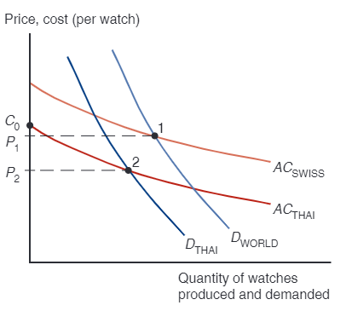
Figure 7.5 External Economies and Losses from Trade
When there are external economies, trade can potentially leave a country worse off than it would be in the absence of trade. In this example, Thailand imports watches from
Switzerland, which is able to supply the world market
at a price
low enough to block entry by Thai producers, who must initially produce the watches
at cost
Yet if Thailand were to block all trade in watches, it would be able to
supply its domestic market
at the lower price,
Notes:
Curve Ay C Swiss is above and parallel to curve Ay C Thai; both fall with decreasing steepness. Curve D world intersects curve Ay C Swiss at point 1, where y = P sub 1. Curve Ay C Thai intercepts the y-axis at C sub 0. Curve D Thai intersects curve Ay C Thai at point 2, which is below and to the left of point 1, where y = P sub 2.

Slide 32
Dynamic Increasing Returns (1 of 3)
So far, we have considered cases where external economies depend on the amount of current output at a point in time.
But external economies may also depend on the amount of cumulative output over time.
Dynamic increasing returns to scale exist if average costs fall as cumulative output over time rises.
Dynamic increasing returns to scale imply dynamic external economies of scale.

Slide 33
Dynamic Increasing Returns (2 of 3)
Dynamic increasing returns to scale could arise if the cost of production depends on the accumulation of knowledge and experience, which depend on the production process over time.
A graphical representation of dynamic increasing returns to scale is called a learning curve.

Slide 34
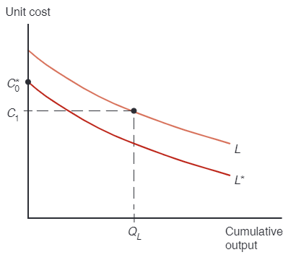
Figure 7.6 The Learning Curve
The learning curve shows that unit cost is lower the greater the cumulative output of a country’s industry to date. A country that has extensive experience in an industry (L) may have a lower unit cost than a country with little or no experience, even if that second country’s
learning curve
is lower—for example, because of lower wages.

Slide 35
Dynamic Increasing Returns (3 of 3)
Like external economies of scale at a point in time, dynamic increasing returns to scale can lock in an initial advantage or a head start in an industry.
Can also be used to justify protectionism.
Temporary protection of industries enables them to gain experience: infant industry argument.
But temporary is often for a long time, and it is hard to identify when external economies of scale really exist.

Slide 36
Interregional Trade and Economic Geography (1 of 3)
External economies may also be important for interregional trade within a country.
Many movie producers located in Los Angeles produce movies for consumers throughout the United States.
Many financial firms located in New York provide financial services for consumers throughout the United States.

Slide 37
Interregional Trade and Economic Geography (2 of 3)
Some nontradable goods like veterinary services must usually be supplied locally.
If external economies exist, the pattern of trade may be due to historical accidents:
Regions that start as large producers in certain industries tend to remain large producers even if another region could potentially produce more cheaply.

Slide 38
Table 7.2 Some Examples of Tradable and Nontradable Industries
Tradable Industries | Nontradable Industries
Aircraft manufacturing | Ready-mix concrete manufacturing
Software publishing | Tax preparation services
Source: Antoine Gervais and J. Bradford Jensen, “The tradability of services: Geographic concentration and trade costs,” working paper, Peterson Institute for International Economics, 2015.

Slide 39
Interregional Trade and Economic Geography (3 of 3)
More broadly, economic geography refers to the study of international trade, interregional trade, and the organization of economic activity in metropolitan and rural areas.
Economic geography studies how humans transact with each other across space.
Communication changes such as the Internet, e-mail, text mail, video conferencing, and mobile phones (as well as modern transportation) are changing how humans transact with each other across space.

Slide 40
Summary (1 of 4)
Trade need not be the result of comparative advantage. Instead, it can result from increasing returns or economies of scale, that is, from a tendency of unit costs to be lower with larger output.
Economies of scale give countries an incentive to specialize and trade even in the absence of differences in resources or technology between countries.
Economies of scale can be internal (depending on the size of the firm) or external (depending on the size of the industry).

Slide 41
Summary (2 of 4)
Economies of scale can lead to a breakdown of perfect competition, unless they take the form of external economies, which occur at the level of the industry instead of the firm.
External economies give an important role to history and accident in determining the pattern of international trade.
When external economies are important, a country starting with a large advantage may retain that advantage even if another country could potentially produce the same goods more cheaply.

Slide 42
Summary (3 of 4)
When external economies are important, countries can conceivably lose from trade.
Also the free-trade price can fall below the price before trade in both countries.
Economic geography refers to how humans transact with each other across space, including through international trade and interregional trade.

Slide 43
Summary (4 of 4)
Trade based on external economies of scale may increase or decrease national welfare, and countries may benefit from temporary protectionism if their industries exhibit external economies of scale either at a point in time or over time.

Slide 44

Copyright
This work is protected by United States copyright laws and is provided solely for the use of instructors in teaching their courses and assessing student learning. Dissemination or sale of any part of this work (including on the World Wide Web) will destroy the integrity of the work and is not permitted. The work and materials from it should never be made available to students except by instructors using the accompanying text in their classes. All recipients of this work are expected to abide by these restrictions and to honor the intended pedagogical purposes and the needs of other instructors who rely on these materials.

